Slide 1
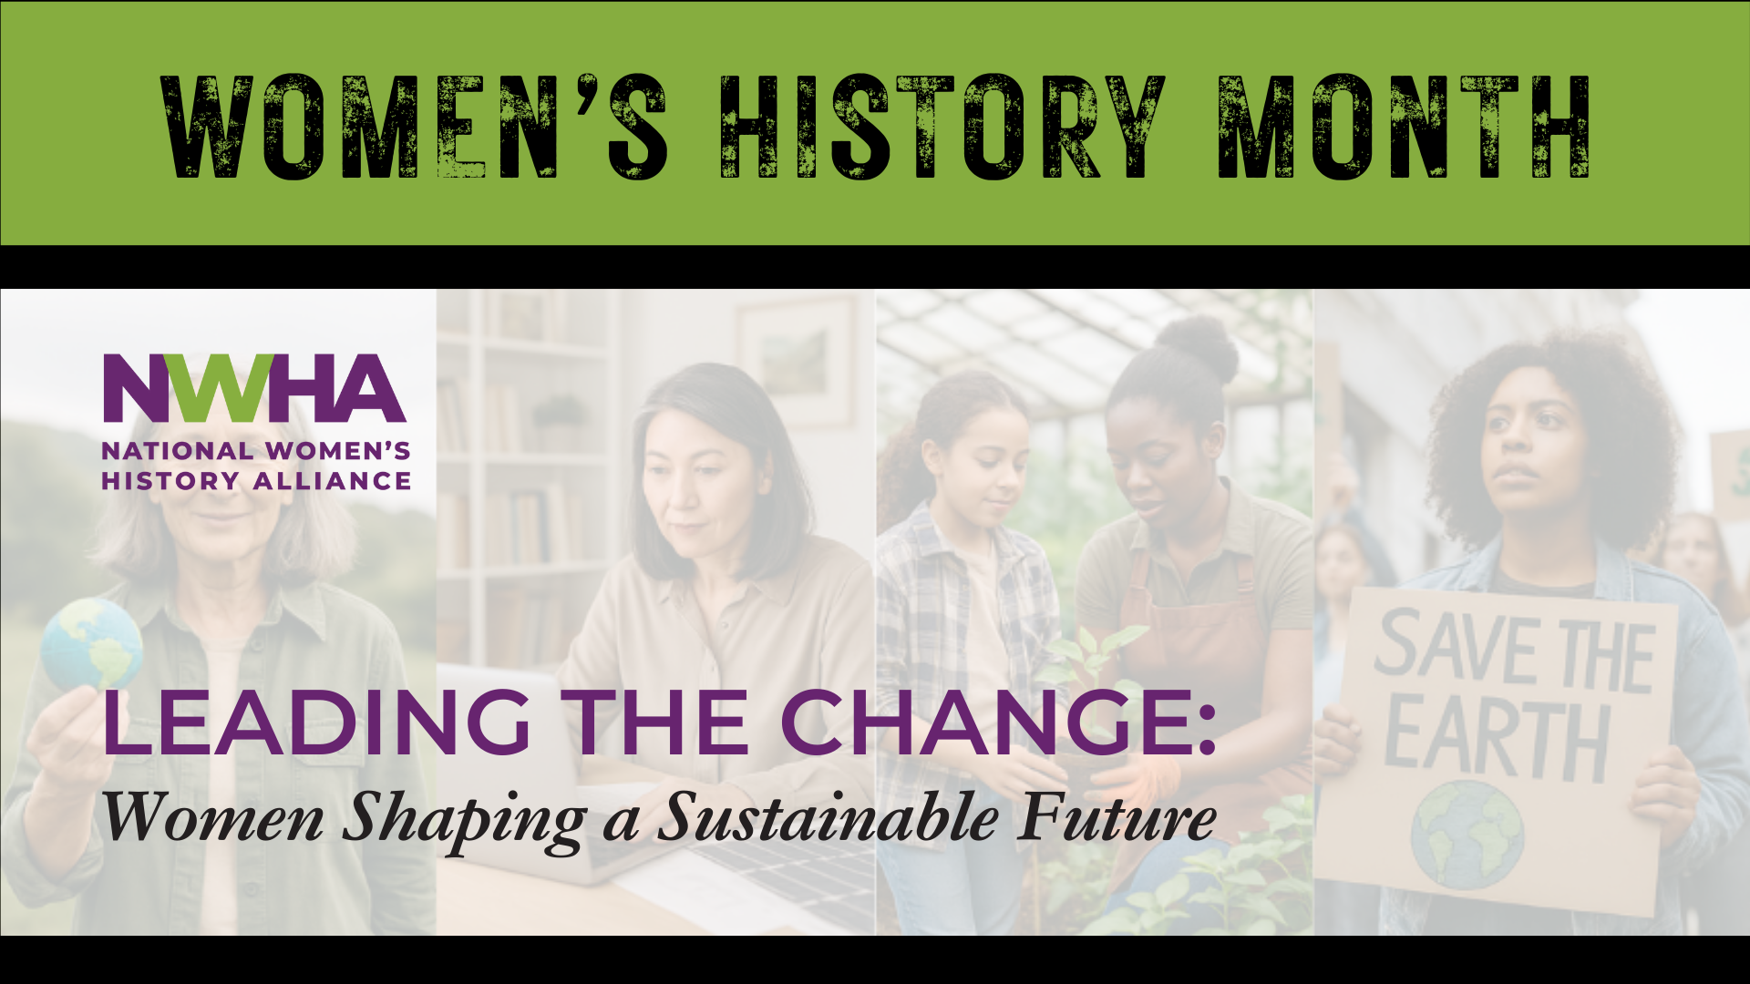
Notes:
Before we dive into today’s program, I’d like to take a moment to introduce the organization behind this work —
the National Women’s History Alliance .

Slide 2
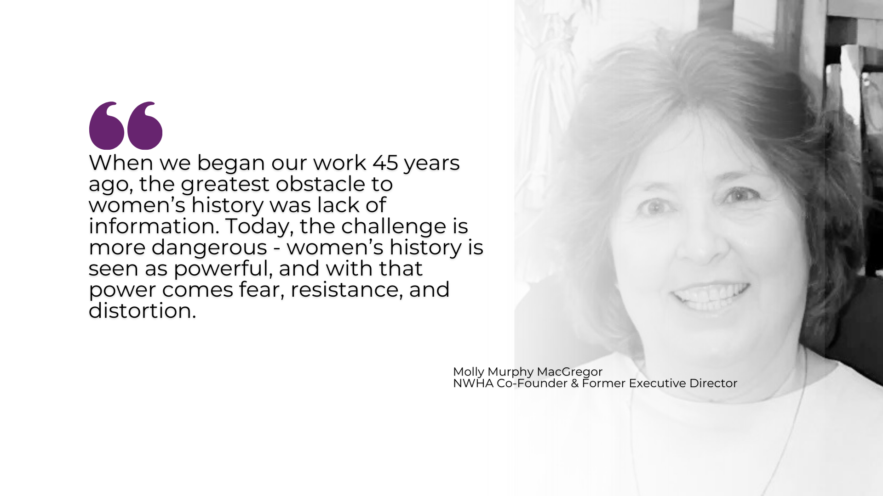

Notes:
The NWHA has been a driving force in promoting and preserving women's history for over four decades. Founded to ensure that women’s contributions are recognized in our schools, communities, and national consciousness, the Alliance has worked tirelessly to uplift stories too often left out of history books.
Each year, NWHA develops the official Women’s History Month theme used by schools, libraries, and institutions nationwide. In addition to this monthly series, we offer toolkits, speakers, partnerships, and year-round programs to help bring women’s history into every space every month.

Slide 3
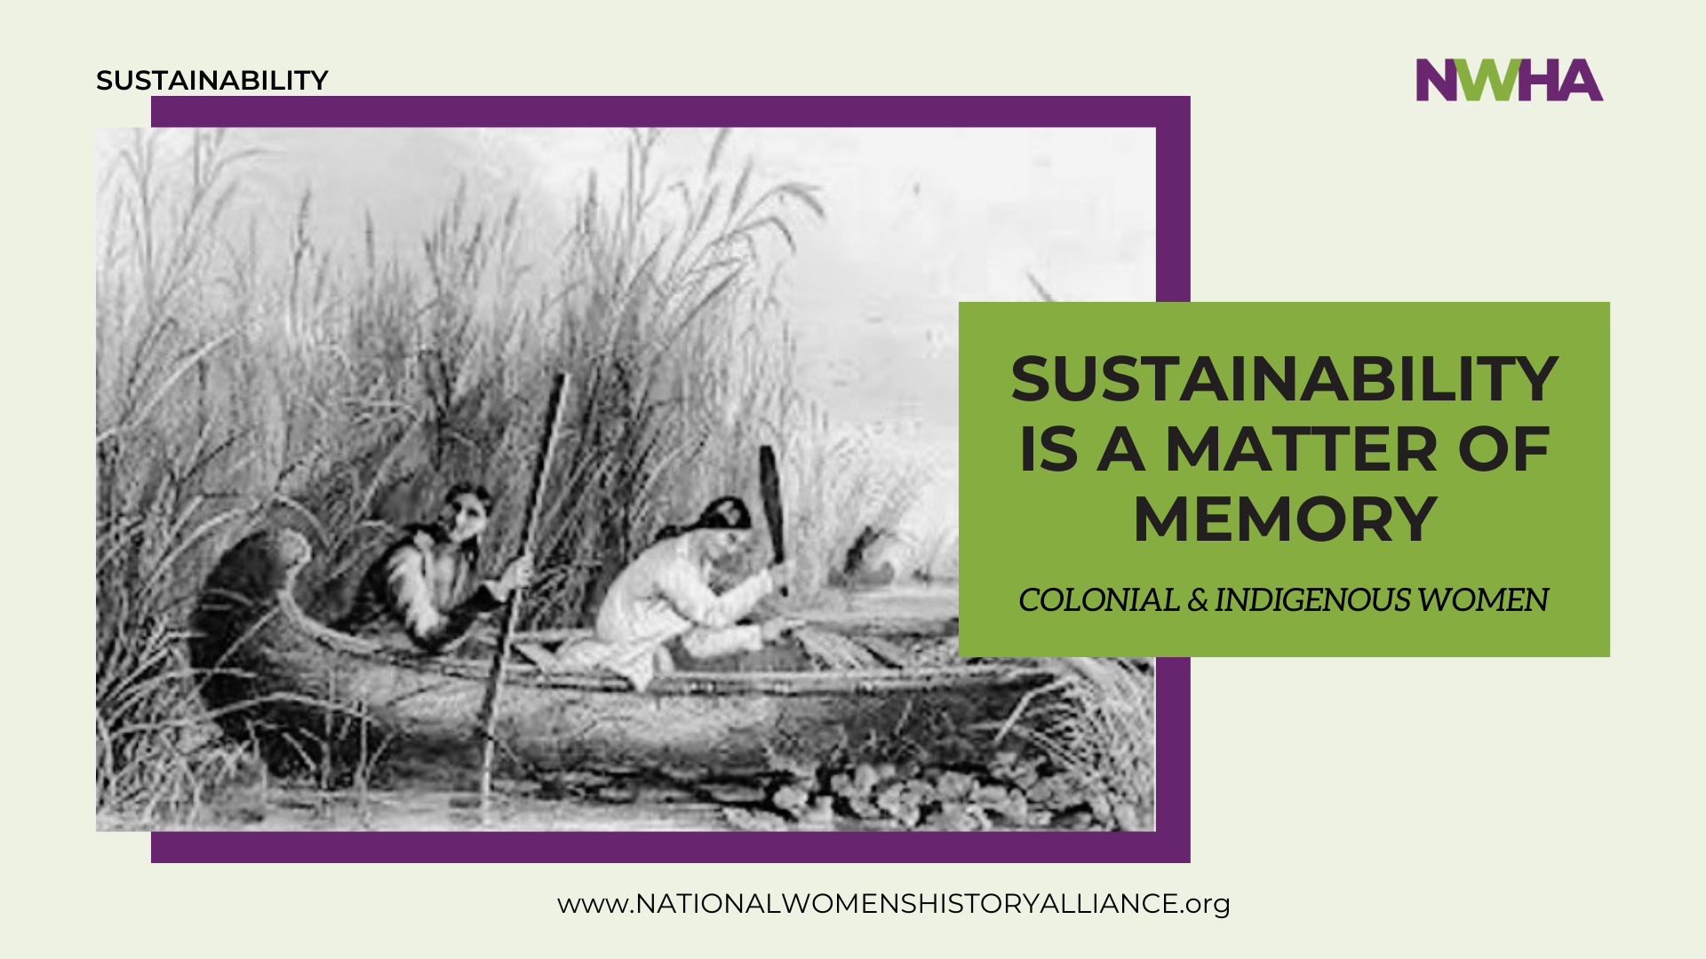
Notes:
Sustainability is often framed as a challenge to be solved by technology or policy — something we must innovate our way toward. But sustainability is really a matter of memory. What we choose to remember, and what we have forgotten, shape how we live on the land, how we value one another, and how far into the future we plan.
Long before “sustainability” entered the modern vocabulary, Indigenous and colonial women lived it — through planting and preserving, healing and restraint, and intimate care for the land that sustained them. When colonial women encountered Indigenous women r in 17th-century America, their exchanges unfolded not in councils or treaties, but in kitchens, gardens, birthing rooms, and campsites. In these quiet, woman-to-woman spaces, one of the earliest and most consequential exchanges of ecological knowledge took place. Across cultural and religious divides, colonial women learned from Indigenous women who knew the land intimately and shared that knowledge generously and advancing complementing and advancing colonial women's knowledge. Individually recognizing what meant the difference between life and death, their knowledge now speaks directly to the survival of our planet and care for the land is inseparable from care for life itself.

Slide 4
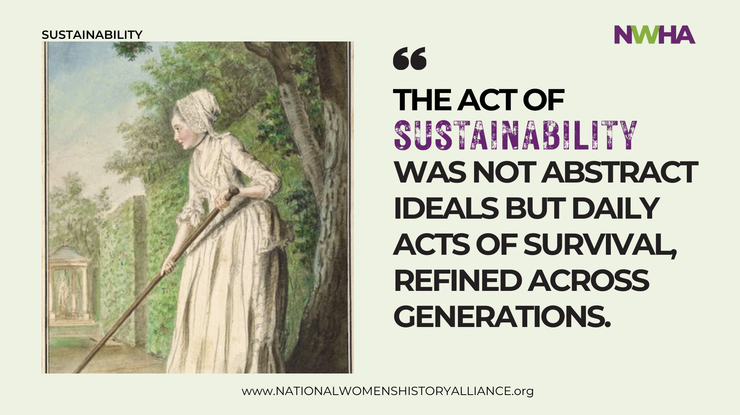
Notes:
What we now call sustainability existed long before it had a name — and it was practiced largely by women. It lived in gardens and kitchens, in seed saving and food preservation, in careful water use, healing traditions, births and deaths, and an ethic of responsibility. These were not abstract ideals but daily acts of survival, refined across generations. Women understood that life depended on balance, renewal, and care.
This knowledge spread woman to woman, mother to child, forming an intergenerational web of sustainable practices that still goes on today. As societies industrialized, this wisdom was devalued, but it endured. Women’s work was labeled domestic rather than ecological, informal rather than essential. But essential it is.

Slide 5
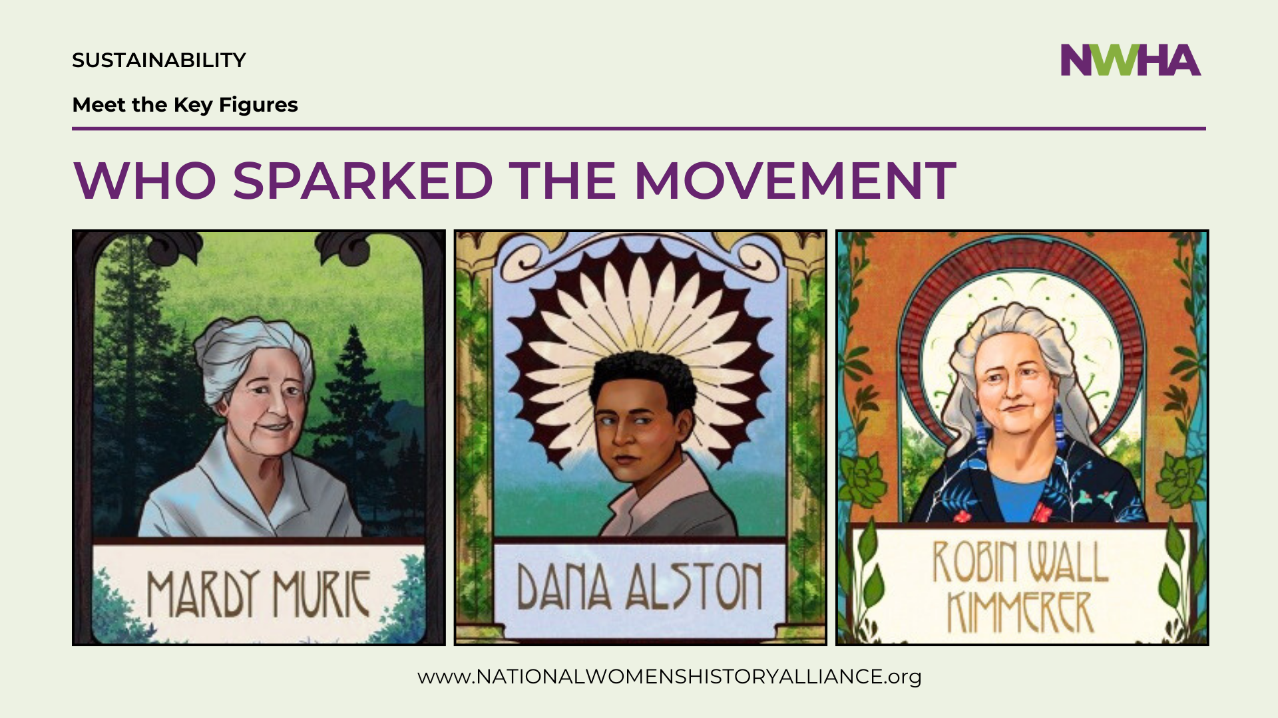
Notes:
Contemporary Indigenous women like Mardy Murie called the “Grandmother of Conservation,” championed wilderness protection in Alaska and other states. Her advocacy helped pass the Wilderness Act and expand Arctic preserves.
Dana Austin led several community based environmental activist organizations and co-convened the first National People of Color Environmental Leadership Summit which amplified the voices of marginalized communities throughout the ’80s and ’90s.
Robin Kimmerer, author of Braiding Sweet Grass, which explores “indigenous wisdom, scientific knowledge, and the teachings of plants". She is an educator and who started Center for Native Peoples and the Environment.

Slide 6
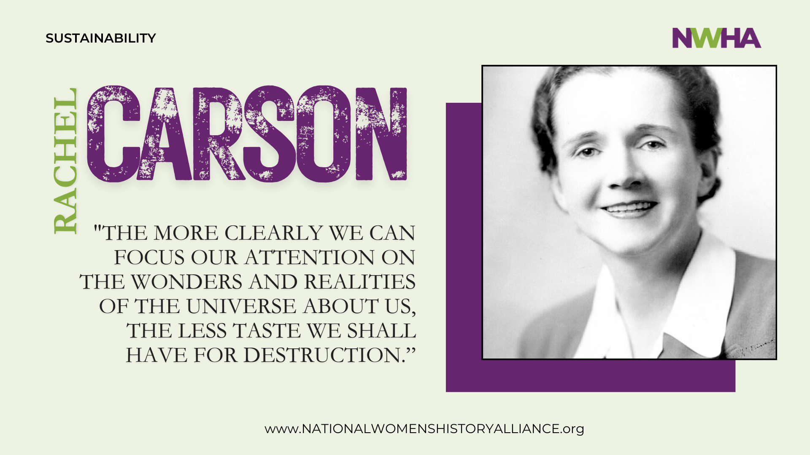
Notes:
Voices like Rachel Carson's joined centuries of other women's voices to sound the alarm life and land cannot endlessly give without replenishment, that mass production carries hidden costs, and communities fracture when only profit is considered. Carson wrote,
"The more clearly we can focus our attention on the wonders and realities of the universe about us,
the less taste we shall have for destruction.”

Slide 7
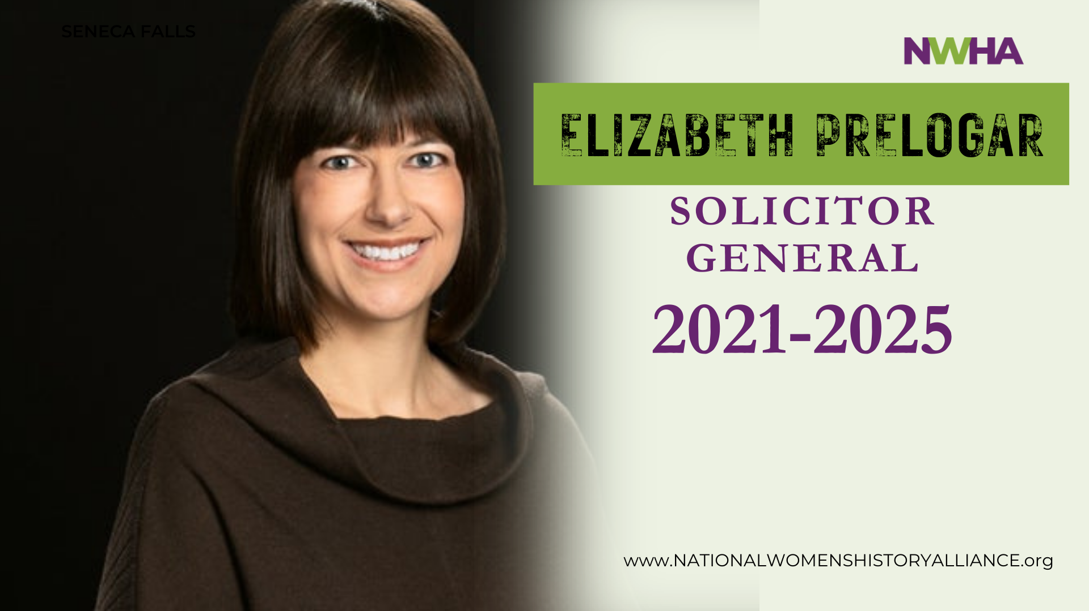
Notes:
Elizabeth Prelogar helped ensure the success of the work of these women as well as the thousands who followed.
When serving as Solicitor General from 2021- 2025 she emerged as one of the federal government’s most visible defenders
of environmental regulation.
Facing a skeptical Supreme Court, she was successful in redefining environmental law by persuading the justices that
long-standing regulatory frameworks still fit within the bounds of Congressional intent
Women have consistently insisted that sustainability must include dignity, health, and care for what we have inheited. The simple truth holds sustainability is not only about preserving nature, it is aboutpreserving life itself..

Slide 8
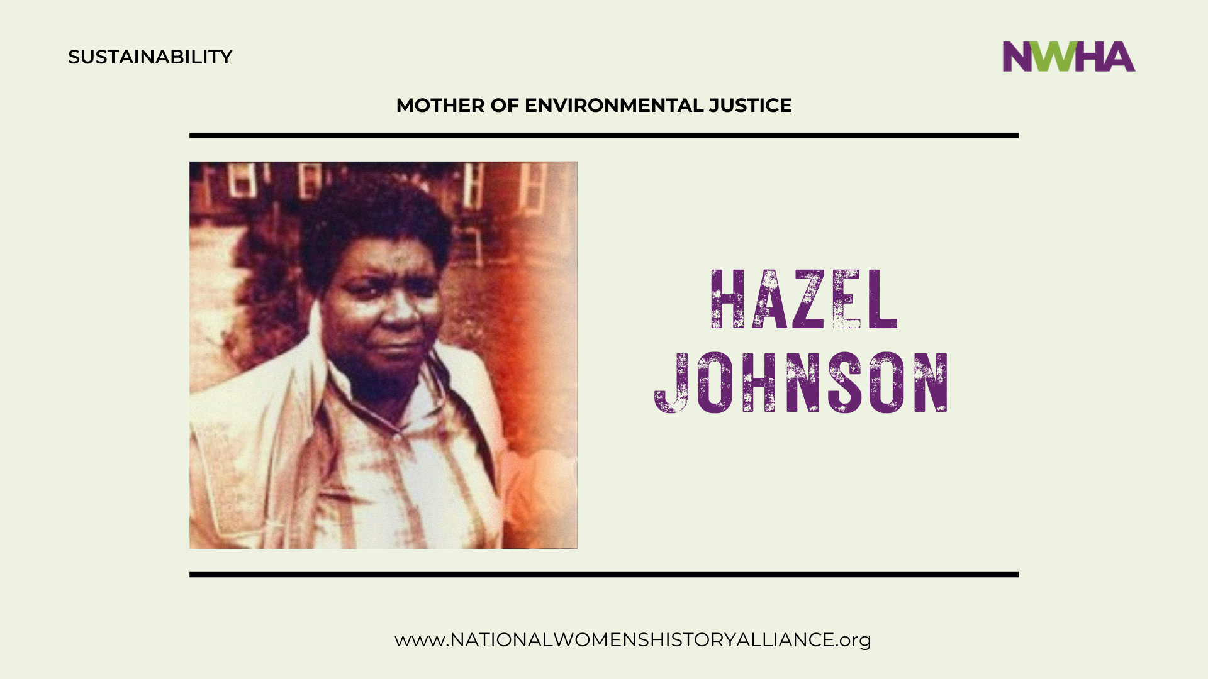
Notes:
Hazel M. Johnson joined countless and rose as leaders in environmental and social justice efforts to organize their communities to shut down dangerous hazards including toxic cancer causing oil site.
She was known as the “Mother of Environmental Justice,” exposed toxic pollution in Chicago’s South Side during the 1970s.
She founded People for Community Recovery as a grassroots, community-based model for other cities to follow.
Johnson labeled this area the "toxic donut," a name which gained widespread notoriety and shed light on the connection between industrial pollution and negative health outcomes in frontline communities like Altgeld Gardens.

Slide 9
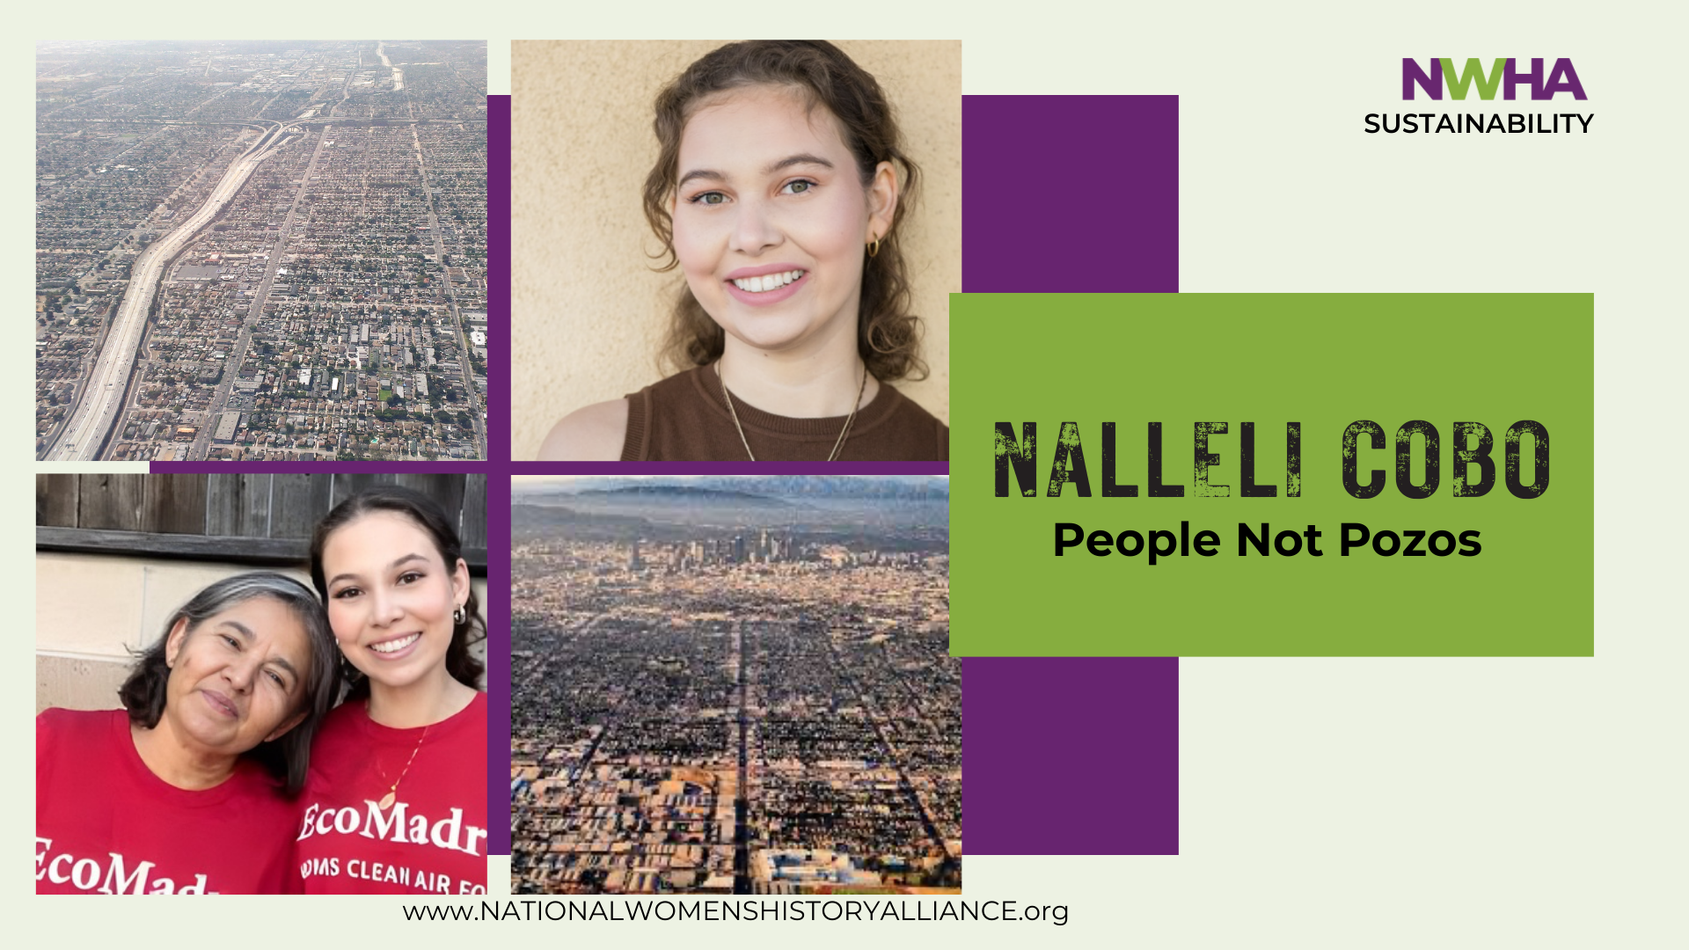
Notes:
Thousand of women continue to work to protect their communities. Against enormous odds, 9 year old Nalleli Cobo with her mother Monic Uriarte, and several neighbors in South Los Angeles., campaigned against the noxious fumes coming from the oil drilling and affecting local residents.
They testified at city meetings, and demanded accountability from powerful oil companies. Cobo learned early on how pollution is permitted where political power is especially scarce in Black and Brown communities. She stepped forward, and grew into a fearless and articulate advocate for environmental justice.
Cobo became co-founder of People Not Pozos (People not Wells), a grassroots campaign and with her leadership,
she led to the successful closure of the Allen Co Energy oil drilling site in their University Park neighborhood.
That victory fueled broader efforts to phase out urban oil drilling across Los Angeles County.

Slide 10
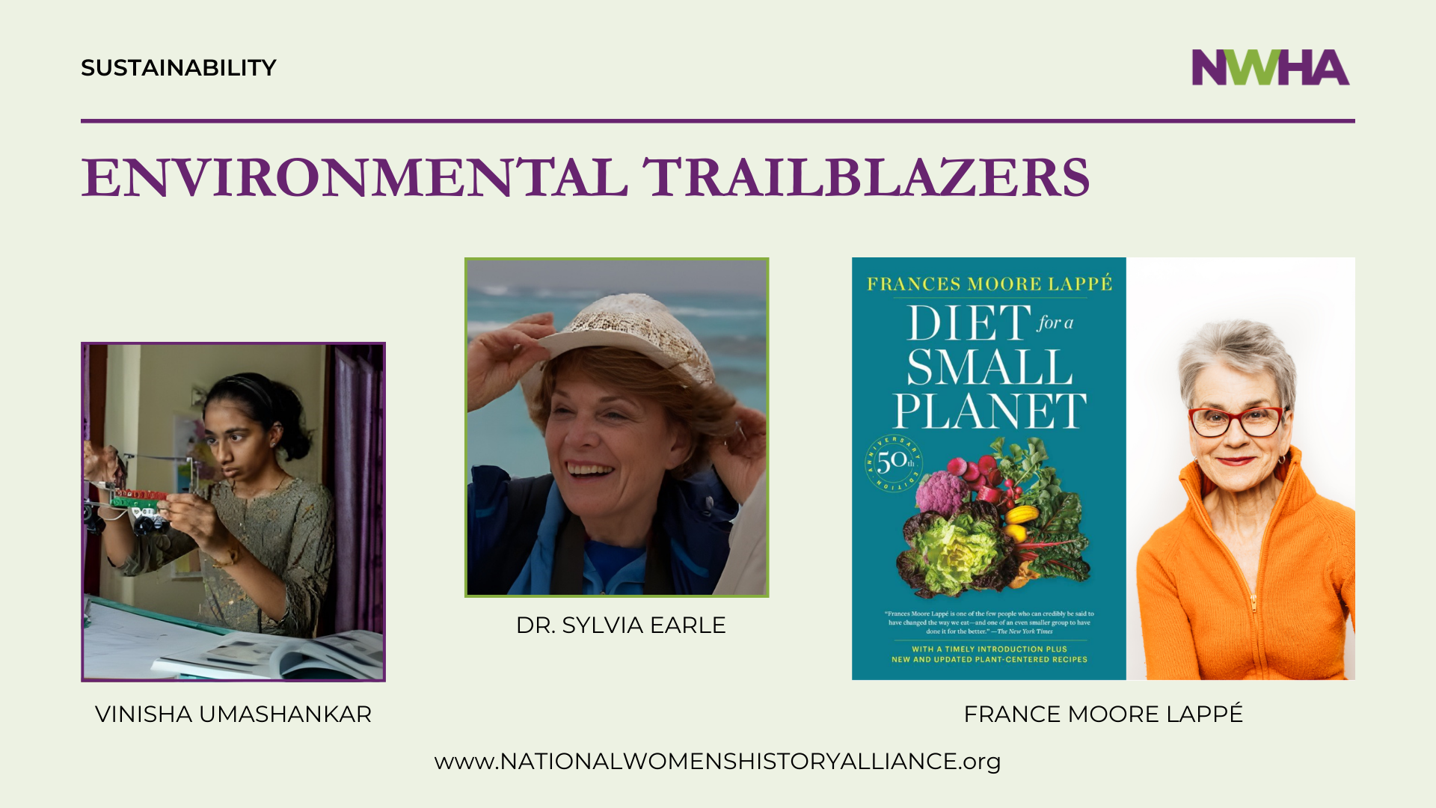
Notes:
Young women scientist use their skills as environmental trailblazers and to also become innovative entrepreneurs.
Working with the business community, they are able to expand the possibilities of all their research
.
Vinisha Umashankar, created a solar-powered cart that replaces charcoal with clean energy, after discovering that burning charcoal poses various medical risks to the lungs. Her creation came to light at the age of 14, showing girls around the globe that it’s never too young to be an innovator.
Dr. Sylvia Earle an American marine biologist oceanographer, explorer, author, and lecturer who also started at an early age. During her lifetime Dr. Earle became an accomplished woman in her field, spending over 7,000+ hours underwater, and leading more than 100+ ocean expeditions.
In 2009, at the age of 74, she founded Mission Blue, to protect marine areas. Through Mission Blue and her advocacy, she helped dramatically raise awareness of ocean health, marine biodiversity, and the importance of protecting ecosystems.
These women and so many others, stand united at the frontlines of environmental change, daring to fight forward in a world that wasn’t built with them - or much of what they valued in mind.
Frances Moor Lappe published Diet for a Small Planet in 1971. The book sold over three million copies and was groundbreaking for arguing that world hunger is not caused by a lack of food but by ineffective food policy.
In addition to information on meat production and its impact on hunger, the book features simple rules for a healthy diet and hundreds of meat-free recipes. "Its mix of recipes and analysis typified radicals' faith in the ability to combine personal therapy with political activism.
It demonstrates the environmental impact of meat production and a contributor to global food scarcity. Lappe argued for environmental vegetarianism—practicing a vegetarian lifestyle out of concerns over animal-based industries and the production of animal-based products.
Knowing history, then, is guidance. In a culture dominated by short-term thinking, historical memory restores perspective.

Slide 11
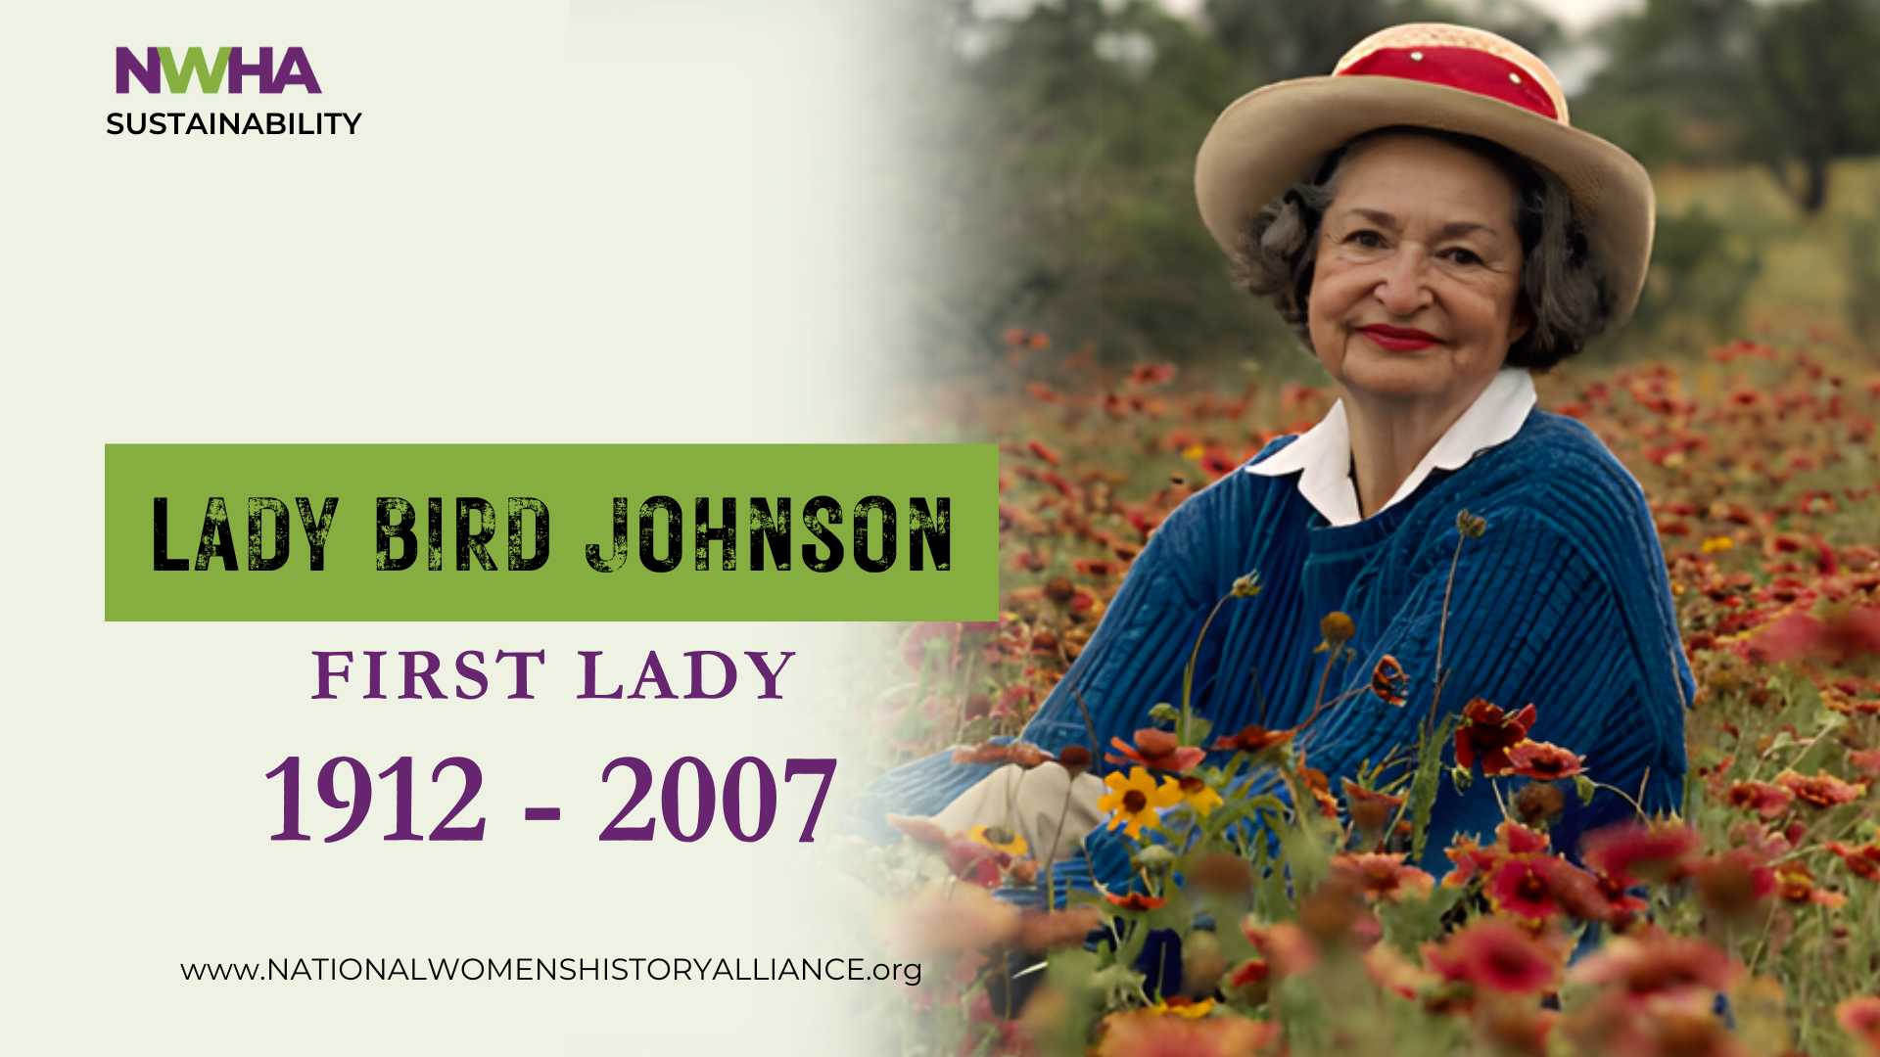
Notes:
First Lady Bird Johnson paid tribute to the importance of honoring and celebrating this history when she said.
“The environment is where we all meet ... a mirror of ourselves, and a focusing lens on what we can become.”
"Lady Bird" Johnson could have been paying tribute to the 5,000 -8,000 women of the California Women's Club
who between 1900 and 1925, campaigned, raised funds, educated communities, and helped establish California’s
first state park at Big Basin in 1902 -- and then two more.
This is one of the largest women-led conservation movements in U.S. history. These women were not “tree huggers,”
but leaders in environmental justice whose legacy still guides us: ordinary women, witnessing destruction,
can defend nature, democracy, and the future.
Lady Bird earned the enduring title of First Lady of the Environment for the pivotal role she played in expanding the
National Park Service, helping create or enlarge nearly fifty park sites.
Her influence also shaped landmark conservation efforts, including wilderness and park preservation initiatives.
Today, her legacy blooms along American highways, in city parks, and in the majestic Lady Bird Johnson Grove
at Redwood National Park.
She taught the nation that beauty is not ornamental — it is essential.

Slide 12
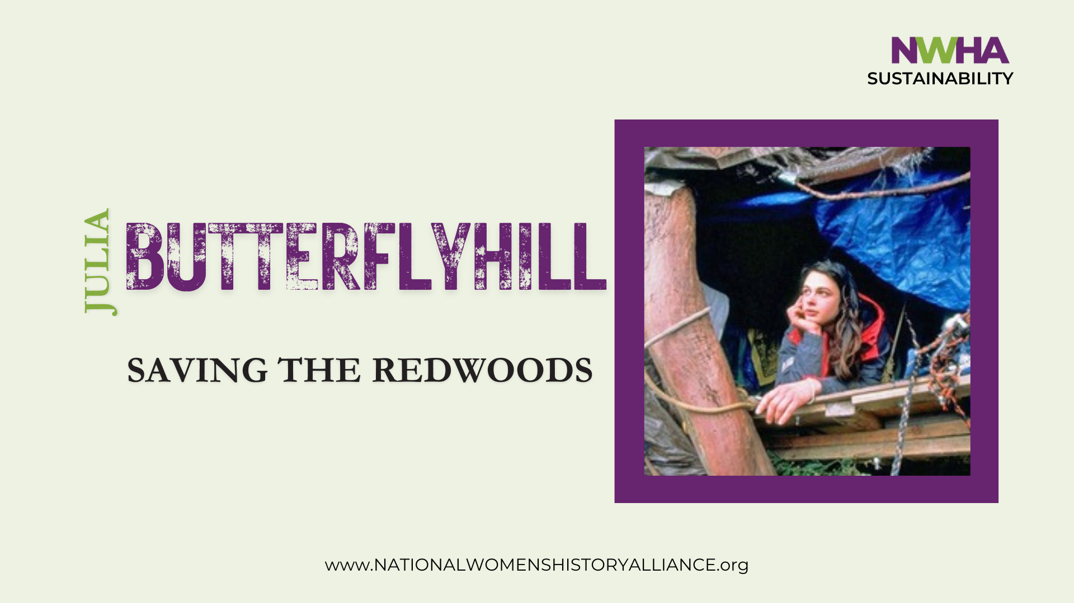
Notes:
Or Lady Bird's words could have been honoring Julia Butterfly Hill and the 738 days — nearly two full years — that
she lived on a small wooden platform 180 feet above the ground in a 1,000-year-old redwood she named Luna, defending this ancient tree’s existence.
Her vigil, beginning in December 1997, became one of the most remarkable acts of nonviolent environmental resistance
in modern history. And it achieved outcomes beyond that time.
Or Lady Bird Johnson's gratitude and tribute could have been to the countless numbers of women who worked throughout their lives to shape a sustainable future.

Slide 13

Notes:
We would like to acknowledge the young women and men who, working with the National Women's History Alliance selected, honored and celebrated 30 individuals for March in our 2026 Women's History Magazine.
The 30 women chosen each represent thousands of others who, in this pivotal moment of history, respond to the vast range of overlapping global challenges: climate change, economic insecurity, healthcare disparities, and threats to democratic participation.
Women’s history reveals an ethic of connection — between people and place, present and future, rights and responsibilities. Knowing women’s history is an act of hope — and a call to action. In our everyday acts of respect, reuse, and responsibility, we carry this legacy forward. We must restore women’s voices, reclaim their wisdom, and act upon it — in policy, in practice, and in daily life.
Let's consider what we can do to create a sustainable future for all of us.

Slide 14
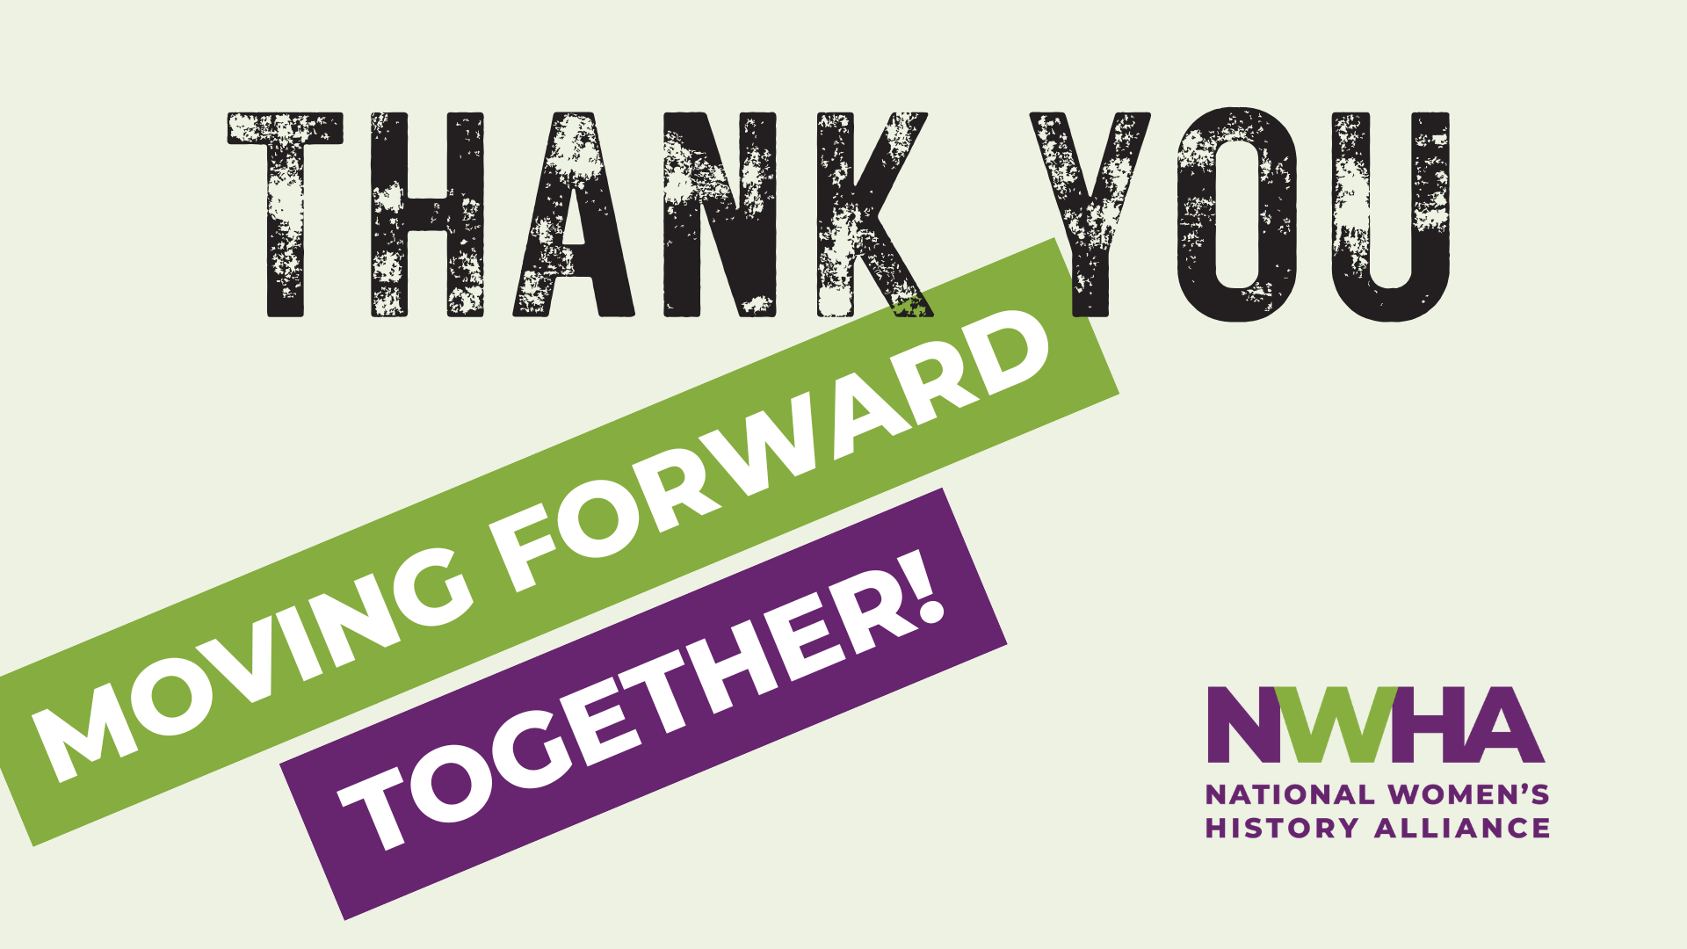
Notes:
Let's consider what we can do to create a sustainable future for all of us.
Let us move forward together!
Thank you.

